Slide 1







SpaceX Falcon 9 first stage Landing Prediction using Data Science.
Ramadhani Maulid
15th February 2024

Slide 2



OUTLINE
Executive Summary
Introduction
Methodology
Results
Visualization – Charts
Dashboard
Discussion
Findings and Implications
Conclusion
Appendix

Slide 3
EXECUTIVE SUMMARY
Data science has been employed to determine if the SpaceX Falcon 9 first stage will land successfully. First stage does most of work, larger than second stage and highly determines the cost of lunch. Cost of the first stage lunch influences decision of opting alternative bids from other space agencies.
Summary of Methodologies
Data Collection through SpaceX REST API and Web Scraping.
Data Transformation through Data Wrangling.
Exploratory data analysis (EDA) using SQL , and Visualization by Pandas and Matplotlib.
Interactive Visual Analytics using Folium (Map) and Plotly Dash (Dashboard)
Predictive analysis using machine learning techniques (support vector machine (SVM), logistic regression, decision trees and K-nearest neighbor (KNN))
Summary of all Results
EDA Results.
Interactive Visual Analytics Results.
Predictive Analysis Results.

Slide 4
INTRODUCTION
SpaceX advertises Falcon 9 rocket launches on its website with a cost of 62 million dollars; other providers cost upwards of 165 million dollars each, much of the savings is because SpaceX can reuse the first stage. Therefore, if we can determine if the first stage will land, we can determine the cost of a launch. Instead of using rocket science to determine if the first stage will land successfully, machine learning model was trained and used public information to predict if SpaceX will reuse the first stage.
Questions to be answered
What are factors that determine successfully landing of a first stage.
What is rate of change of success rate of landing with time.
What are required operating conditions for successfully first stage landing.
What method correctly predict success of landing of first stage.

Slide 5
METHODOLOGY
Reference is made summaries of the methodologies in the executive summary.
Data Collection through SpaceX REST API
Get request performed to obtain launch data from API.
Launch data from get request decoded using .json() method and then converted to dataframe using .json_normalize function.
Defined a series of helper functions that helped using the API to extract information using identification numbers in the launch data.
Create dictionary from data and create a dataframe from it.
Retain only data from launch 9 falcon on the dataframe.
Replace missing values of Payload Mass with calculated .mean()
Export data in the comma separated value (CSV) format.

Slide 6
METHODOLOGY
Data Collection through Web Scraping
Request the Falcon9 Launch Wiki page from its URL and hence Create a BeautifulSoup object from the HTML response.
Extract all column/variable names from the HTML table header.
Defined a series of helper functions that helped using the API to extract information using identification numbers in the launch data.
Create a data frame by parsing the launch HTML tables which is attained by first creating dictionary from data then convert to data frame.
Export data in the comma separated value (CSV) format.

Slide 7
METHODOLOGY
Data Transformation through Data Wrangling.
Exploratory data analysis has been through:
Identifying and calculating the percentage of the missing values in each attribute.
Identifying which columns are numerical and categorical.
Calculating the number of launches on each site.
Calculating the number and occurrence of each orbit.
Calculating the number and occurrence of mission outcome of the orbits.
Creating a landing outcome label from Outcome column.
Data obtained exported in CSV format.

Slide 8
METHODOLOGY
EDA Through Visualization
Performed exploratory Data Analysis and Feature Engineering using Pandas and Matplotlib.
Created plots (Scatter, Bar) used to Visualize the relationship between:
(Flight Number vs Payload, Flight Number vs Launch Site, Payload Mass (kg) vs Launch Site, Payload Mass (kg) vs Orbit type, Success Rate vs Year).
Preliminary insights obtained about how each important variable would affect the success rate, used to select the features that will be used in success prediction.

Slide 9
METHODOLOGY
EDA Through SQL
Data from CSV loaded to database.
Performed SQL queries to get insights from data such as:
Displaying the names of the unique launch sites in the space mission.
Displaying 5 records where launch sites begin with the string ‘CCA'
Displaying the total payload mass carried by boosters launched by NASA (CRS).
Displaying average payload mass carried by booster version F9 v1.1
Listing the date when the first successful landing outcome in ground pad was achieved.

Slide 10
METHODOLOGY
EDA Through SQL (Continued)
Listing the names of the boosters which have success in drone ship and have payload mass greater than 4000 but less than 6000.
Listing the total number of successful and failure mission outcomes.
Listing the names of the booster versions which have carried the maximum payload mass.
List the records which will display the month names, failure landing_outcomes in drone ship ,booster versions, launch_site for the months in year 2015.
Ranking the count of landing outcomes (such as Failure (drone ship) or Success (ground pad)) between the date 2010-06-04 and 2017-03-20 in descending order

Slide 11
METHODOLOGY
Interactive Visual Analytics using Folium
Marked all launch sites on a map and observed their proximity to equator line and the coast (created and inserted map objects such as markers with popup labels, circles, lines to mark the success or failure of launches for each site on the folium map).
Marked the success/failed launches for each site on the map by enhancing map by adding the launch outcomes for each site, and see which sites have high success rates by using the color-labeled marker clusters. Data frame used has detailed launch records, and the class column indicates if this launch was successful or not (0 which means failure mapped to red marker,1 which means success marked to green marker for the map).

Slide 12
METHODOLOGY
Interactive Visual Analytics using Plotly and Dash
Built a Plotly Dash application for users to perform interactive visual analytics on SpaceX launch data in real time.
The dashboard application contains input components dropdown list (You can select all sites or specific site) and a range slider to interact with a pie chart and a scatter point chart.
After visual analysis using the dashboard (pie and scatter charts), some insights obtained to answer the questions such as Which site has the largest successful launches?, Which site has the highest launch success rate?
After visual analysis using the dashboard, you should be able to obtain some insights to answer the following five question
his dashboard application contains input components such as a dropdown list and a range slider to interact with a pie chart and a scatter point chart.

Slide 13
METHODOLOGY
Predictive Analysis was achieved through:
Performing exploratory Data Analysis and determine Training Labels
Creating a column for the class
Standardizing the data
Split into training data and test data
Finding best Hyperparameter for Support Vector Machines (SVM), Classification Trees, Logistic Regression and K-Nearest Neighbor(KNN)
Find the method performs best using test data.
After visual analysis using the dashboard, you should be able to obtain some insights to answer the following five question
his dashboard application contains input components such as a dropdown list and a range slider to interact with a pie chart and a scatter point chart.

Slide 14
RESULTS
EDA Through Visualization Results
To achieve EDA number of plots have been created to visualize relationships between features.
The results for relationship are covered in the next slides(TITLE shows the features/columns involved in visualization of their relationship)
Scatter(catplot) and Bar plots were used due to nature of the nature .

Slide 15
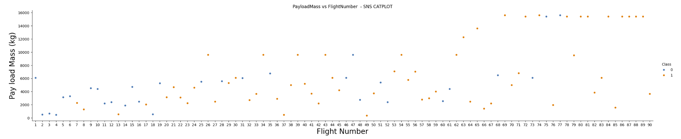
RESULTS
EDA Through Visualization Results

Slide 16
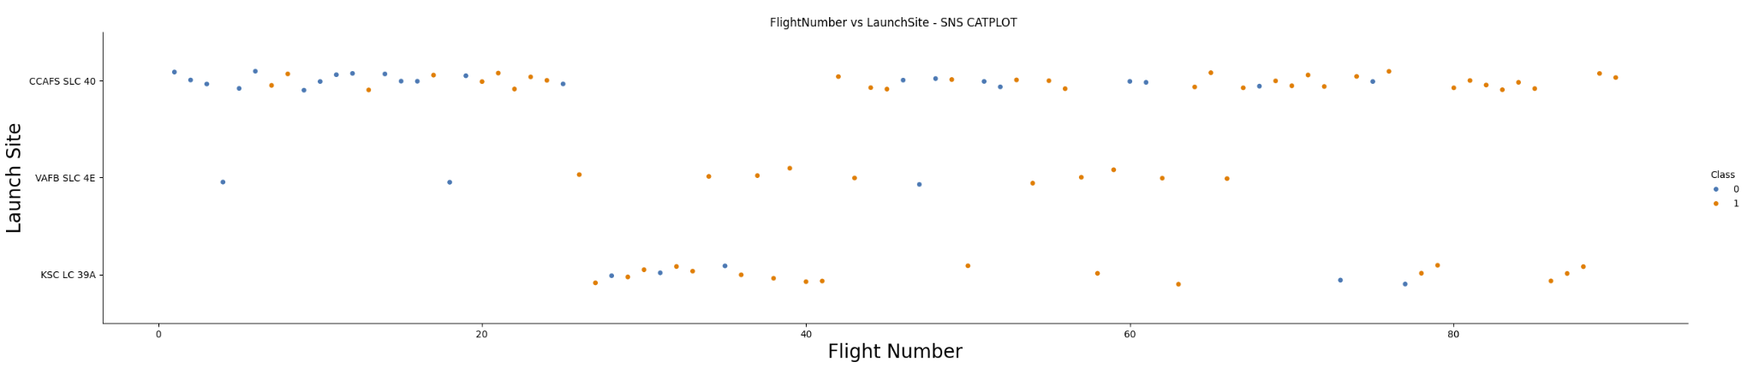
RESULTS
EDA Through Visualization Results

Slide 17
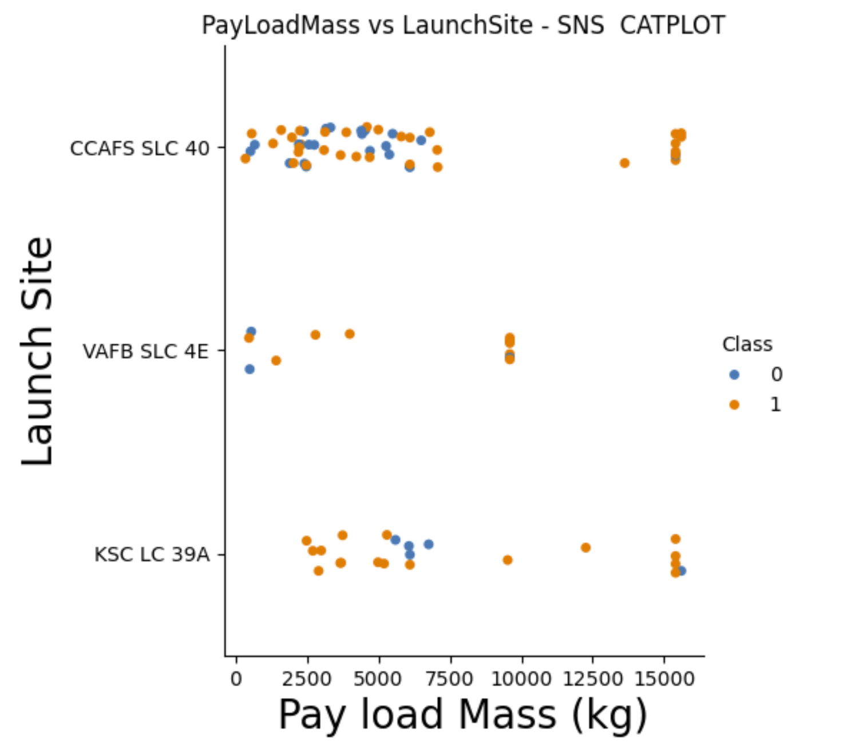
RESULTS
EDA Through Visualization Results

Slide 18
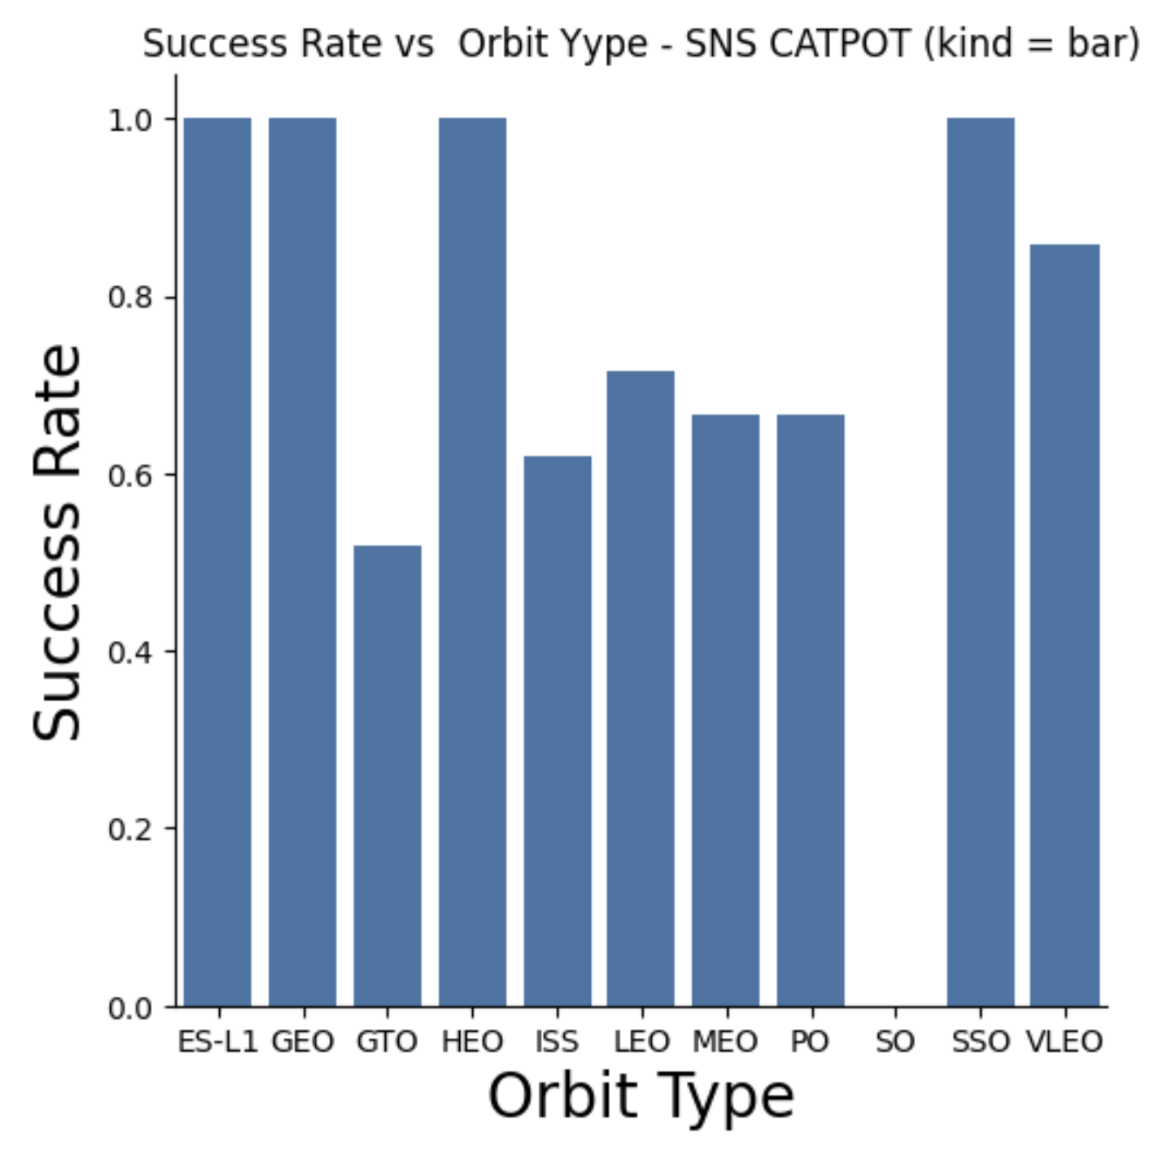
RESULTS
EDA Through Visualization Results

Slide 19
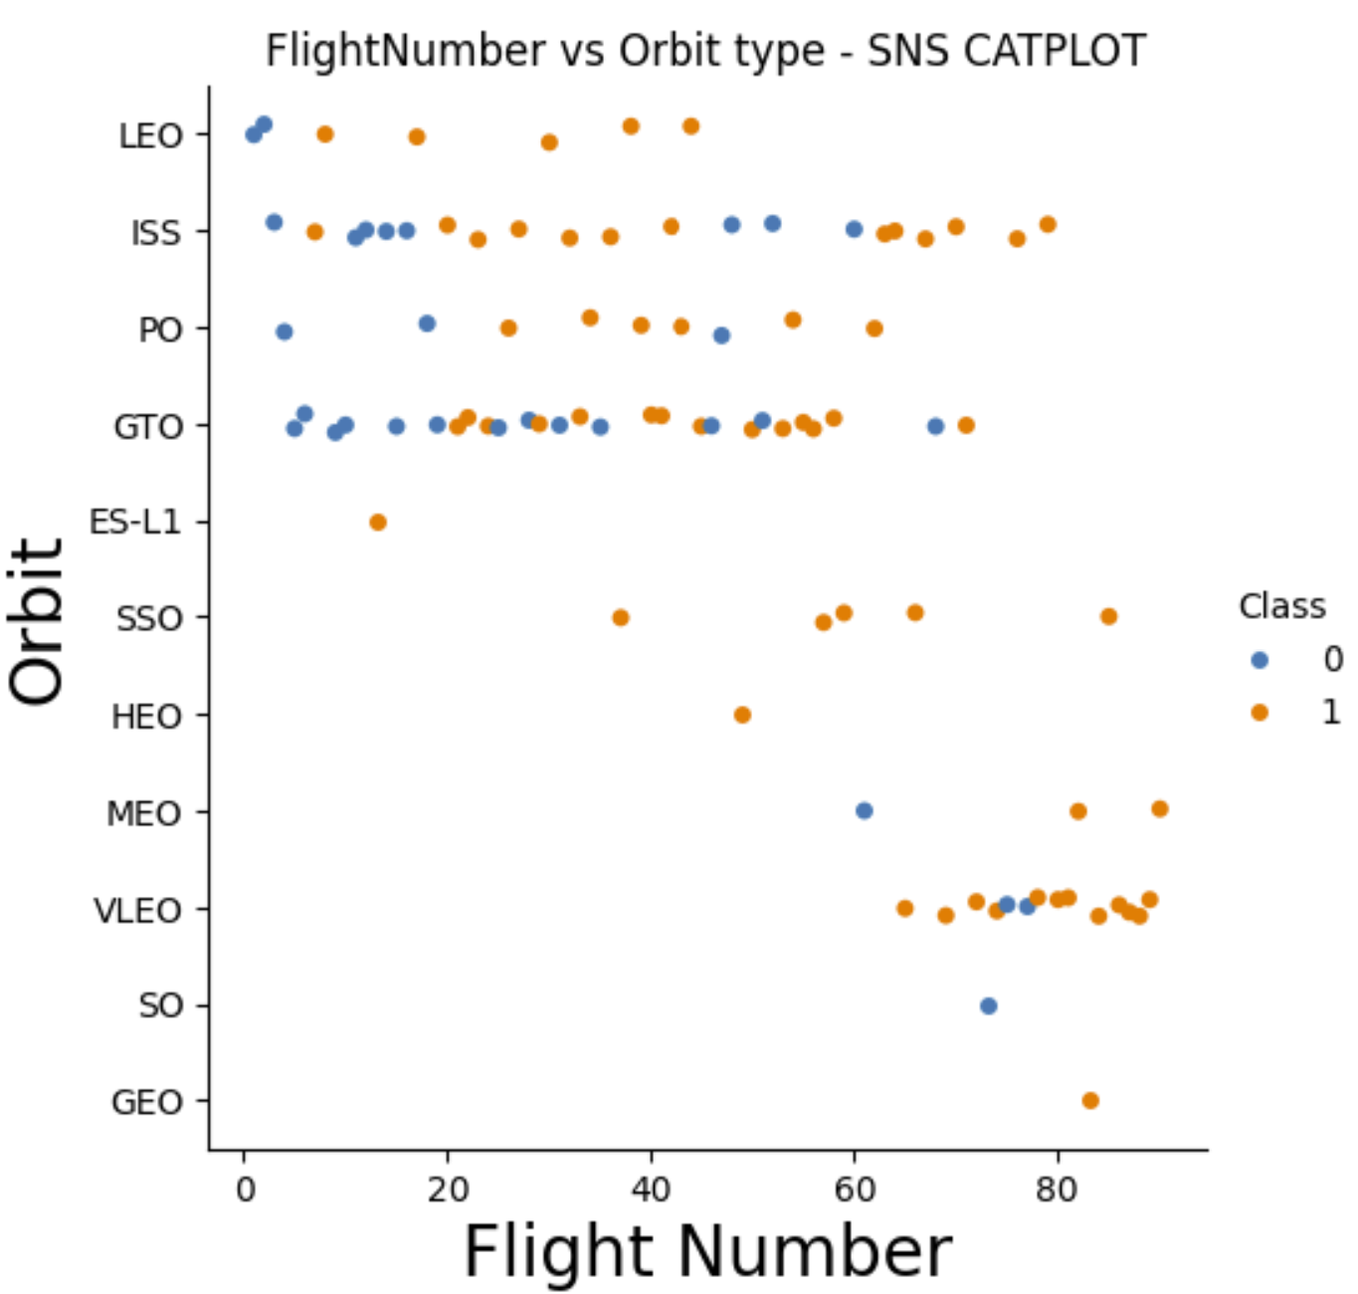
RESULTS
EDA Through Visualization Results

Slide 20
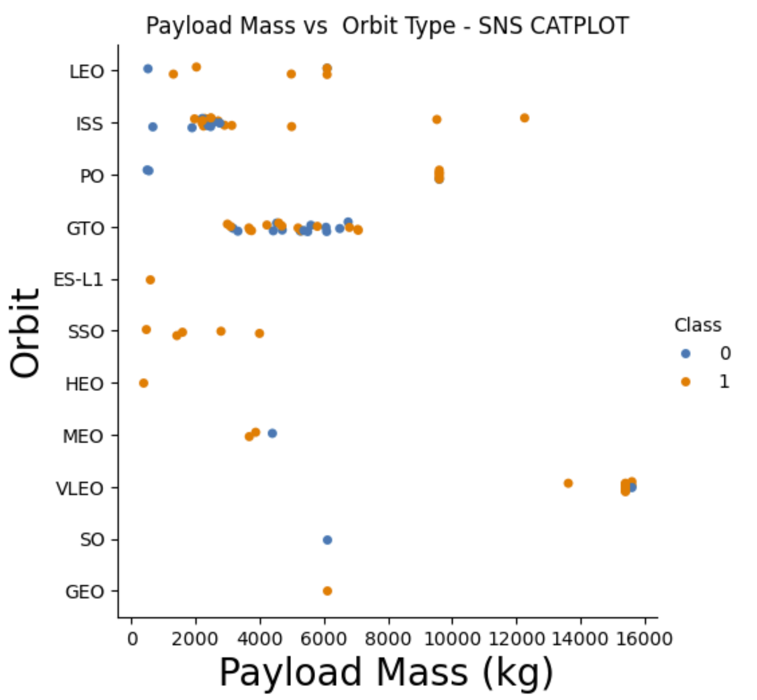
RESULTS
EDA Through Visualization Results

Slide 21
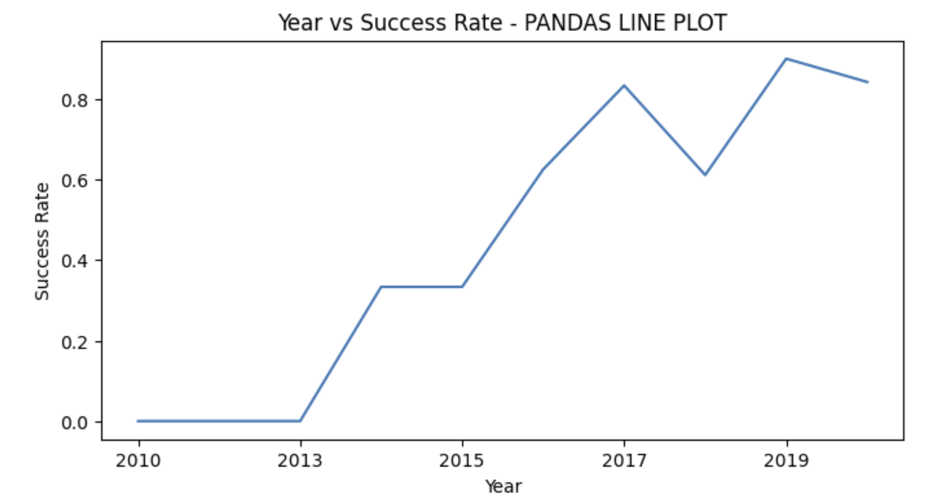
RESULTS
EDA through Visualization Results

Slide 22
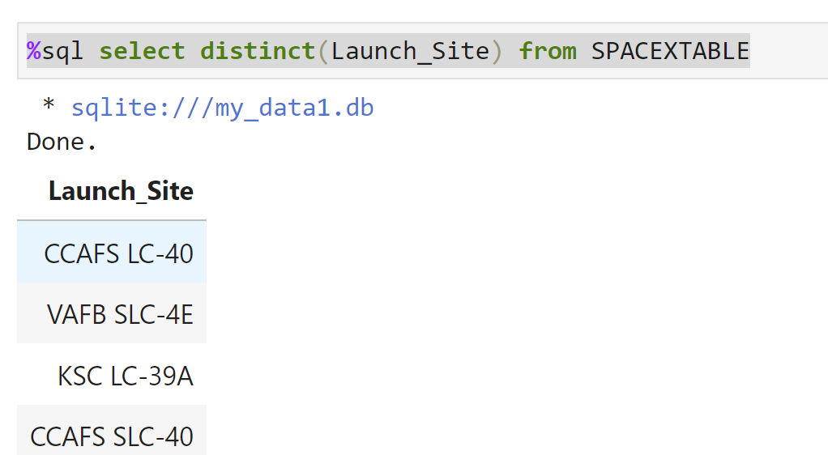
RESULTS
EDA Through SQL Results (names of the unique launch sites)

Slide 23
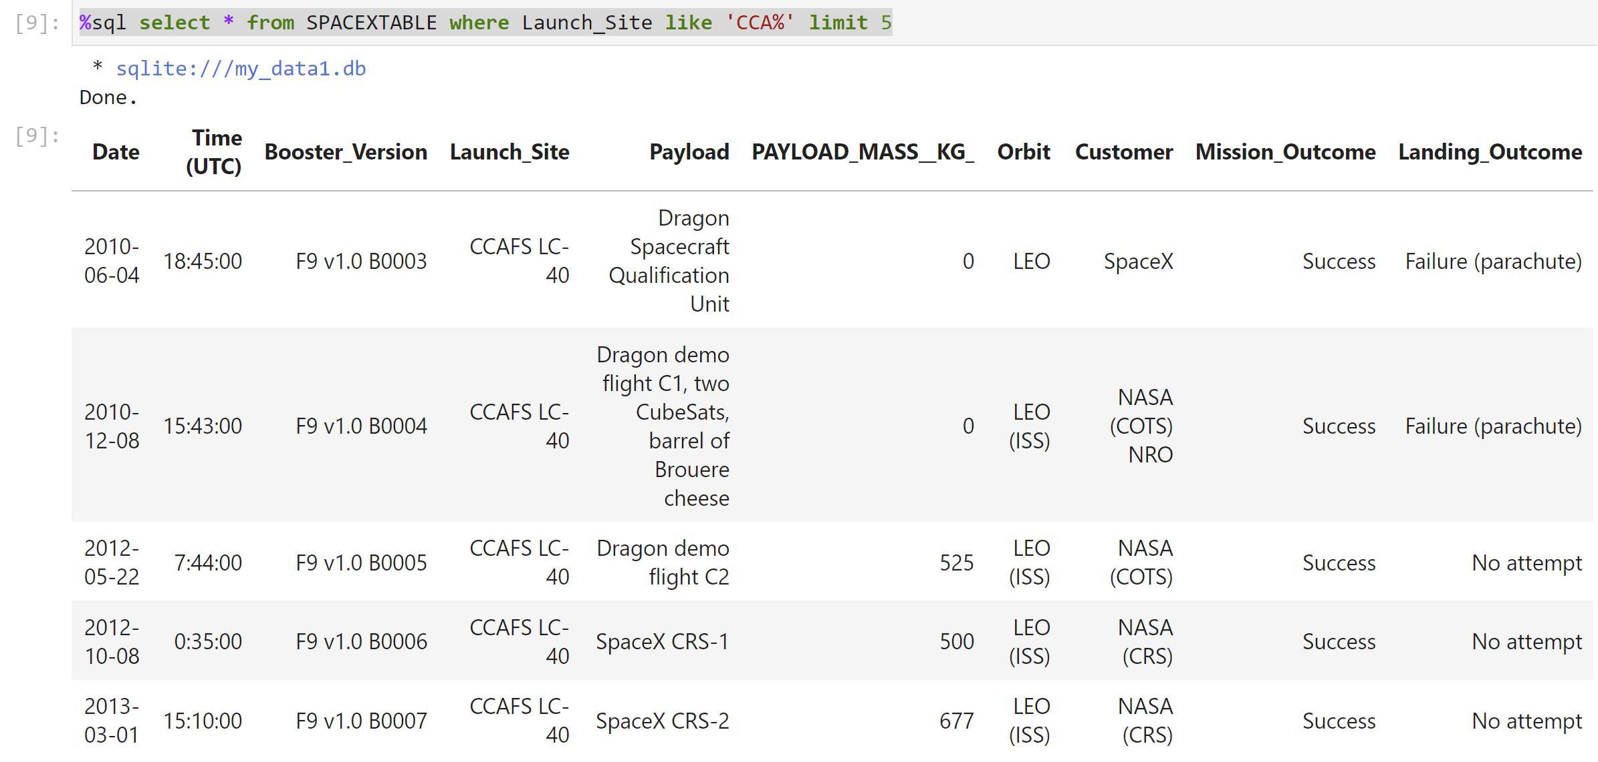
RESULTS
EDA Through SQL Results (5 records that launch sites begin with 'CCA')

Slide 24
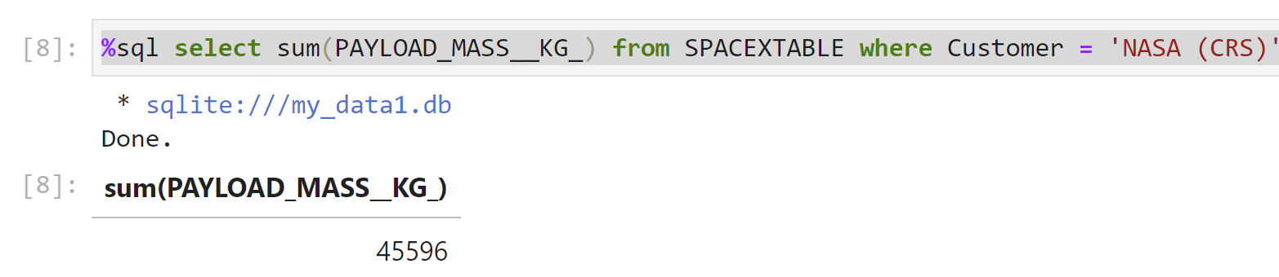
RESULTS
EDA Through SQL Results (total payload mass by NASA(CRS) boosters)

Slide 25
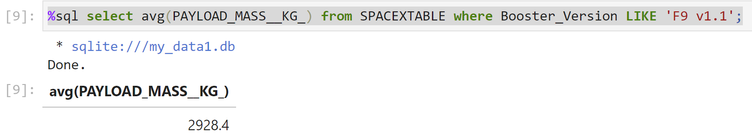
RESULTS
EDA Through SQL Results (average payload mass carried by booster version F9 v1.1)

Slide 26
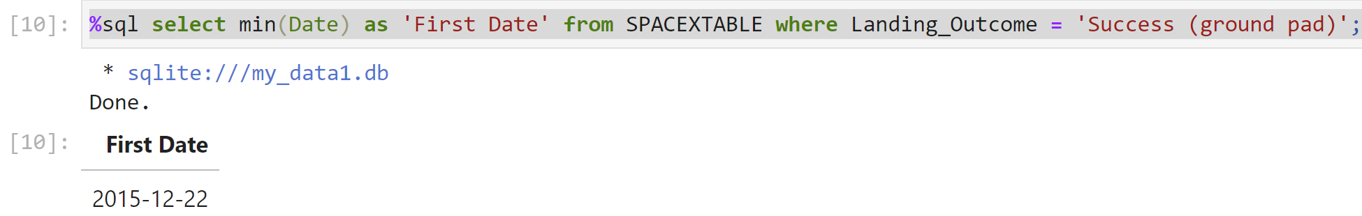
RESULTS
EDA Through SQL Results (date when the first successfully landing outcome in ground pad was achieved)

Slide 27
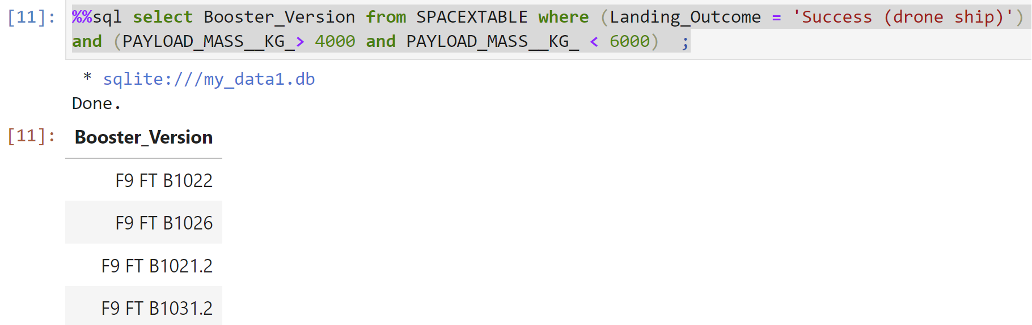
RESULTS
EDA Through SQL Results (names of the boosters which have success in drone ship and have payload mass greater than 4000 but less than 6000)

Slide 28
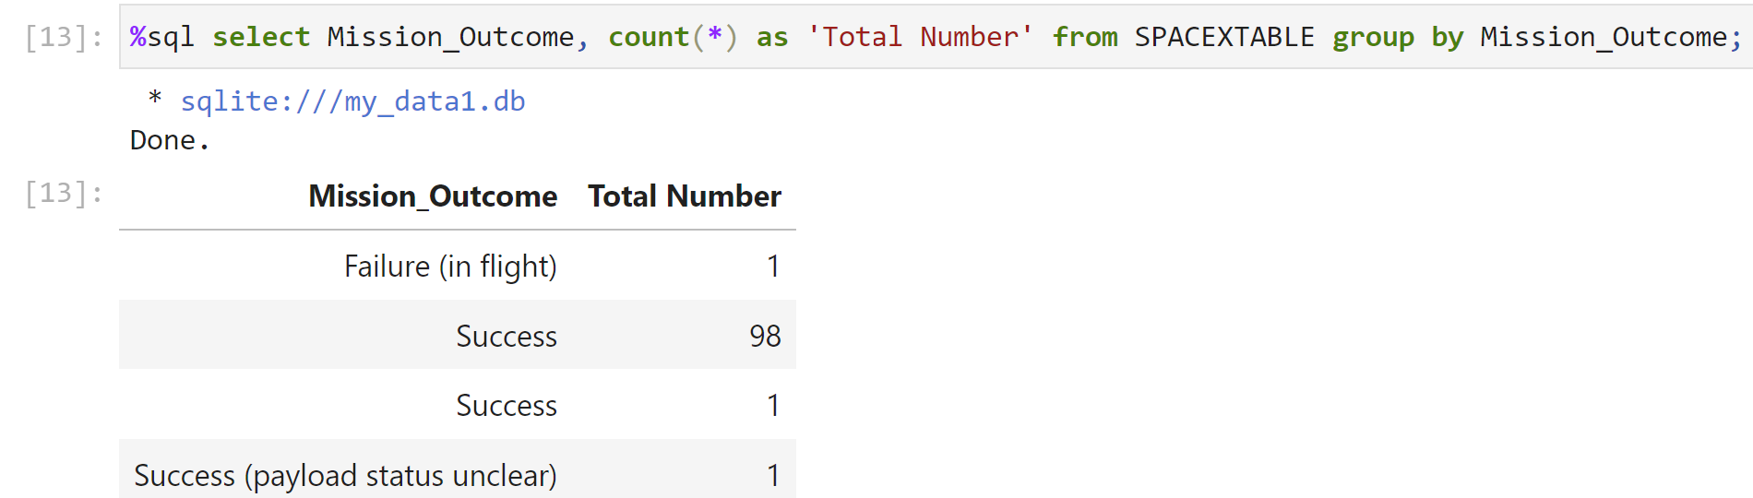
RESULTS
EDA Through SQL Results (total number of successful and failure mission outcomes)

Slide 29
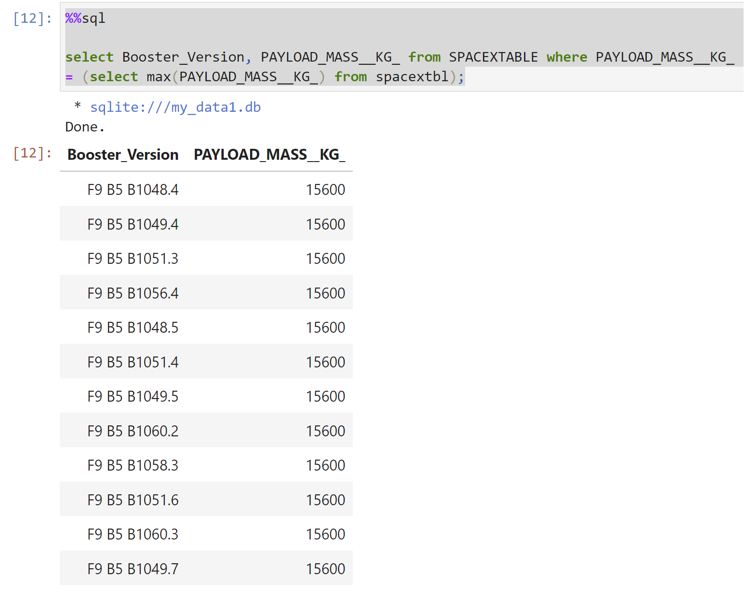
RESULTS
EDA Through SQL Results (names of the booster_versions which have carried the maximum payload mass use a subquery)

Slide 30
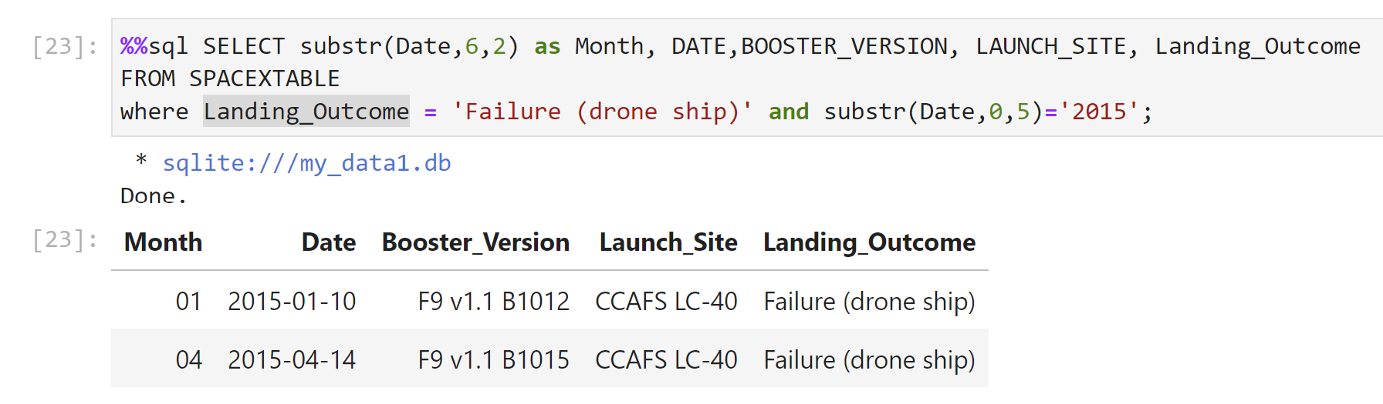
RESULTS
EDA Through SQL Results (he month names, failure landing_outcomes in drone ship ,booster versions, launch_site for the months in year 2015).

Slide 31
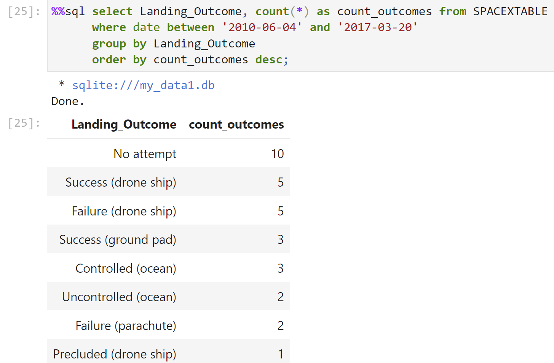
RESULTS
EDA Through SQL Results (count of landing outcomes (such as Failure (drone ship) or Success (ground pad)) between the date 2010-06-04 and 2017-03-20, in descending order)

Slide 32
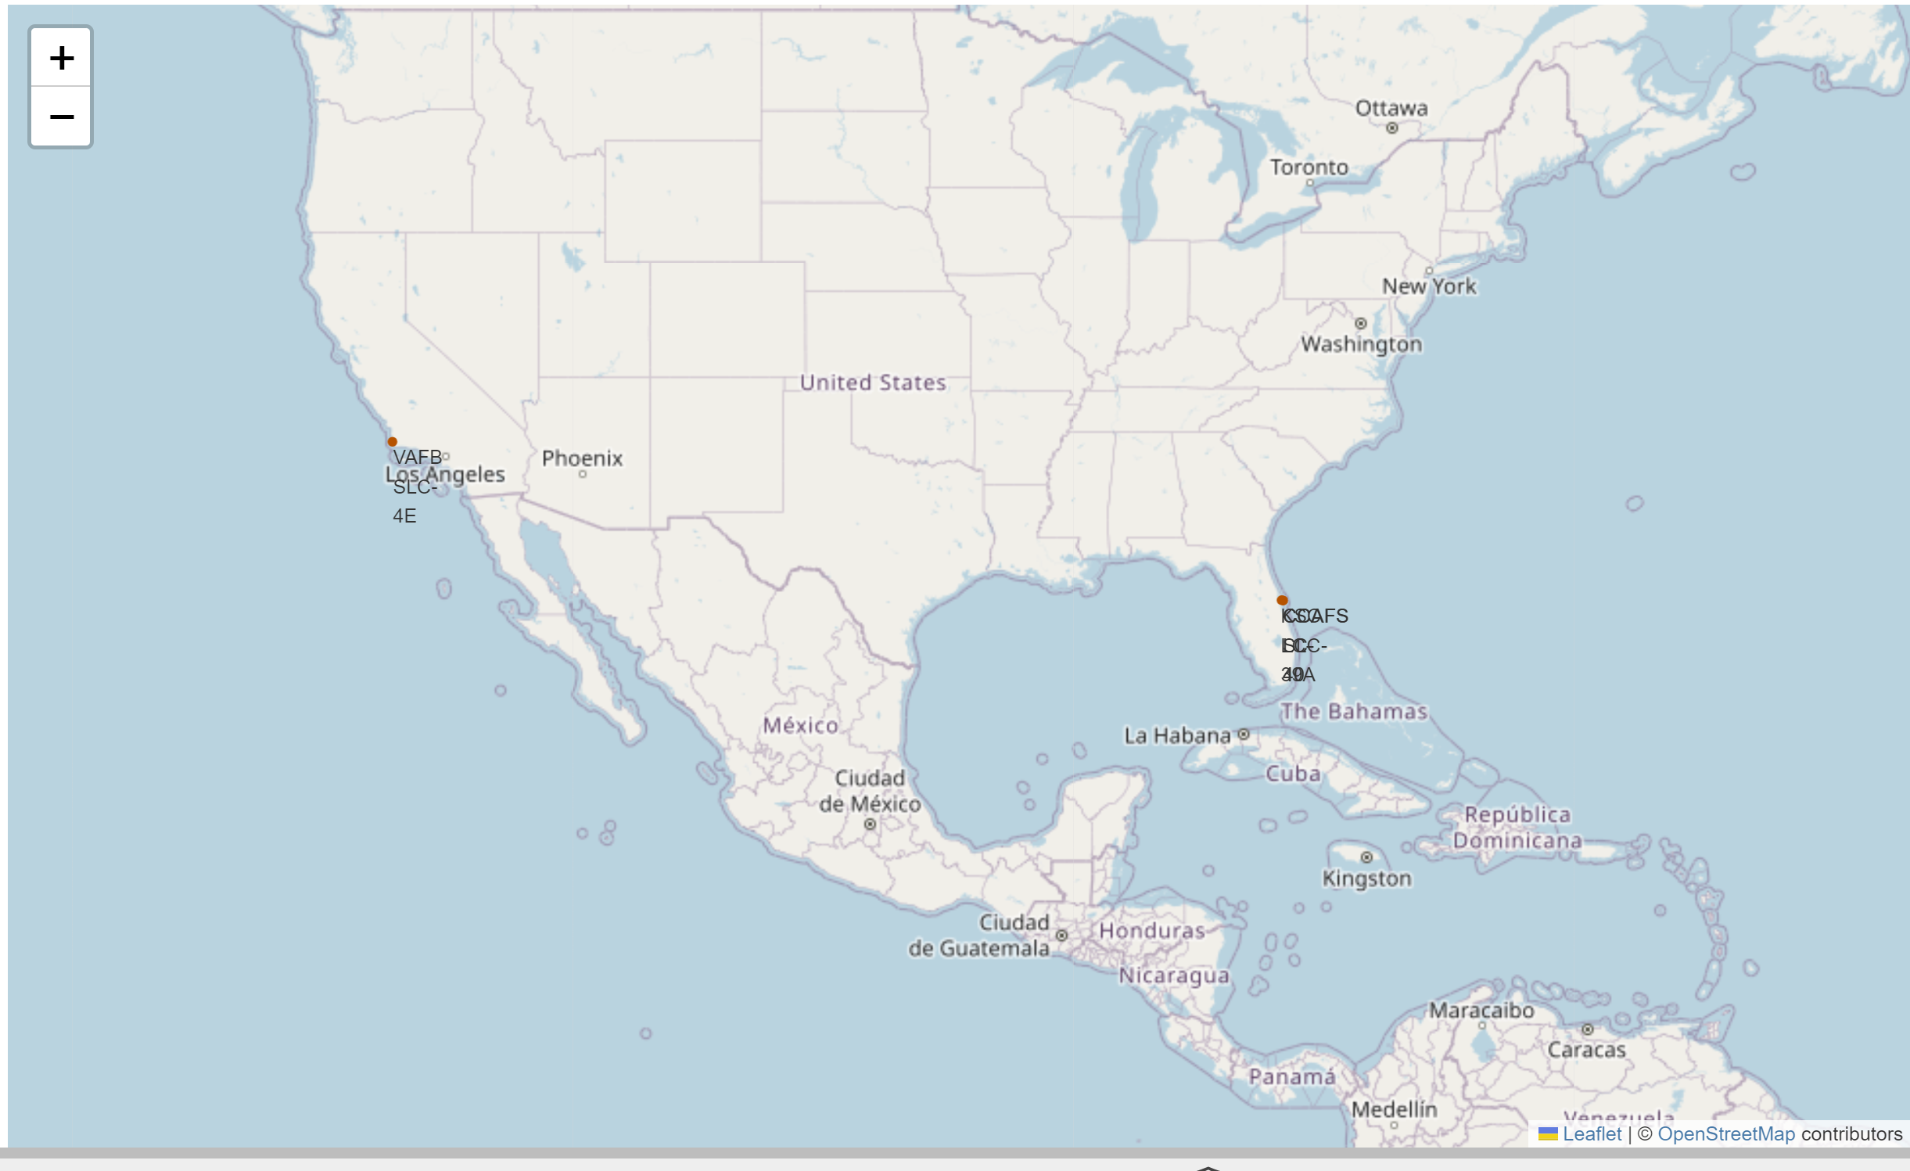
RESULTS
Interactive Visual Analytics with Folium
Mark all launch sites on a map (All sites are close proximity to equator and coast)

Slide 33
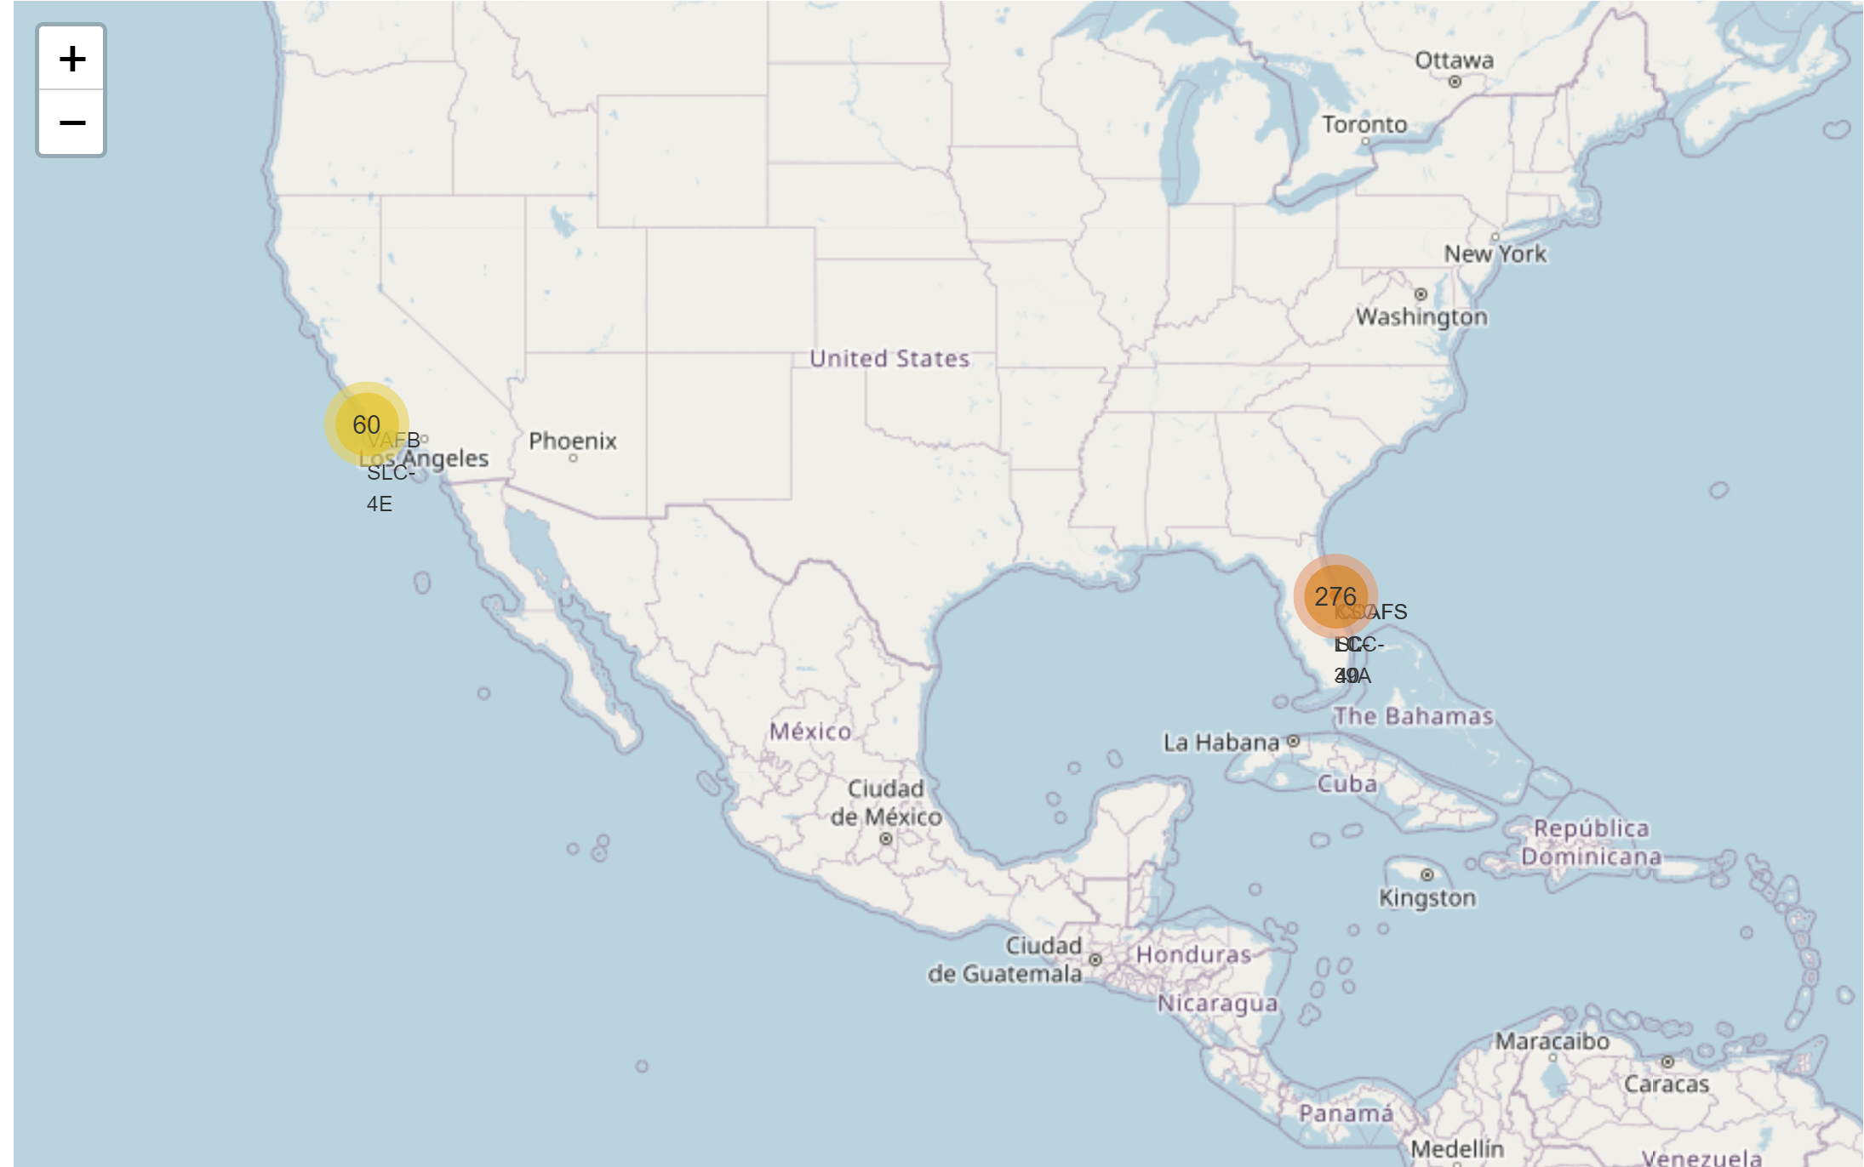
RESULTS
Interactive Visual Analytics with Folium
Mark the success/failed launches for each site on the map

Slide 34
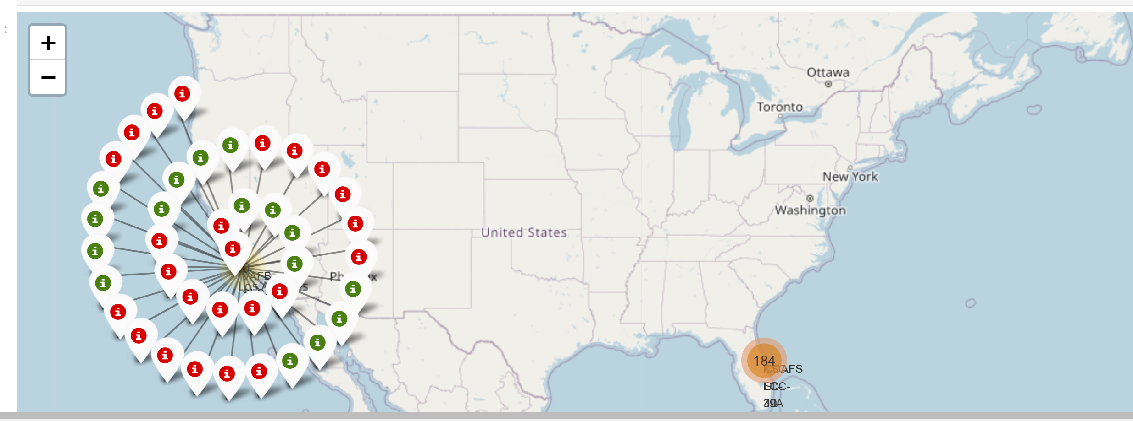
RESULTS
Interactive Visual Analytics with Folium
Mark the success/failed launches for each site on the map (Green for Success, Red for Failure, this is obtained upon double clicking of the circles in previous plot)

Slide 35
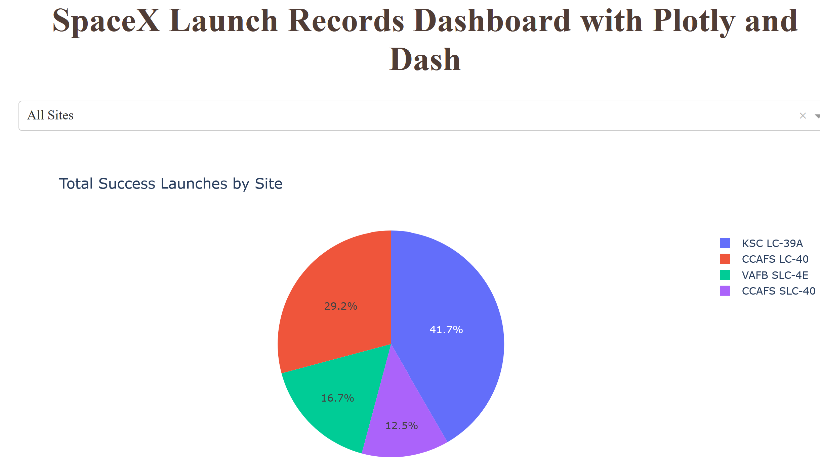
RESULTS
Interactive Visual Analytics with Plotly and Dash
Total Success Launches by Site (KSC LC-39A has the largest successful launches).

Slide 36
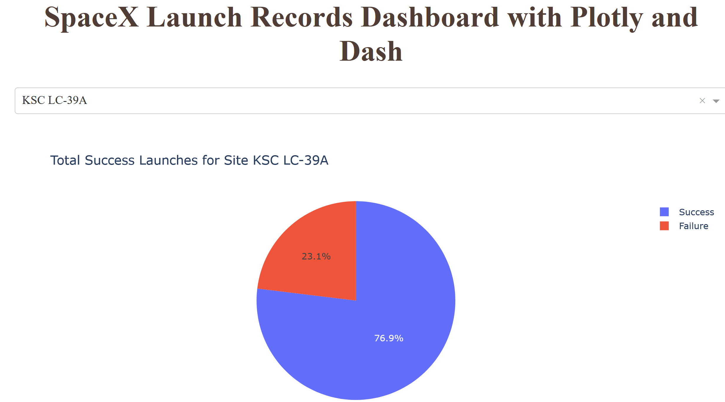
RESULTS
Interactive Visual Analytics with Plotly and Dash
Success Launches Rate by Selecting Specific Site (KSC LC-39A has the highest launch success rate (76.9)).as the highest launch success rat

Slide 37
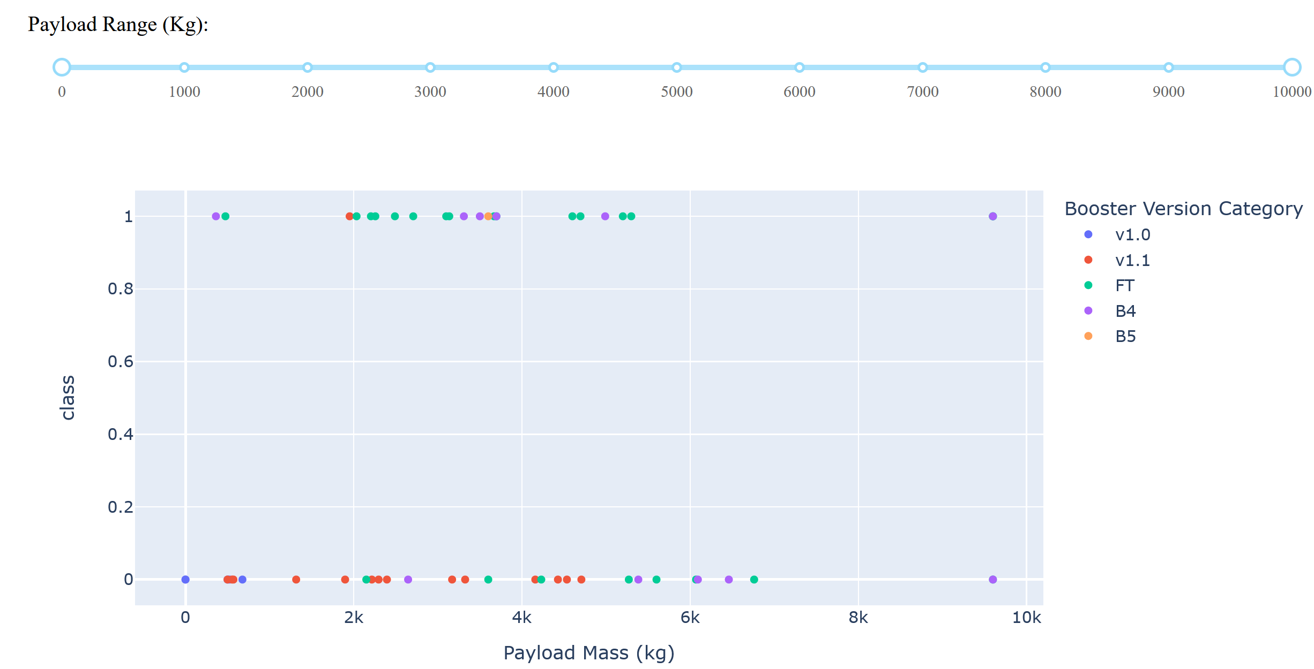
RESULTS
Interactive Visual Analytics with Plotly and Dash
Considering Payload Mass and Success by Booster Version (Payloads between 2,000 Kg and 5,000 Kg have the highest success rate) as the highest launch success rat

Slide 38
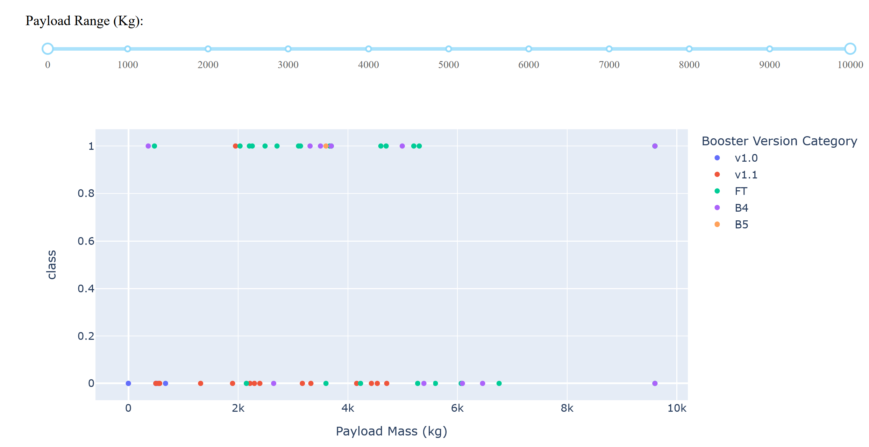
RESULTS
Interactive Visual Analytics with Plotly and Dash
Considering Payload Mass and Success by Booster Version (Payloads above 6,000Kg have the lowest success rate).as the highest launch success rat

Slide 39
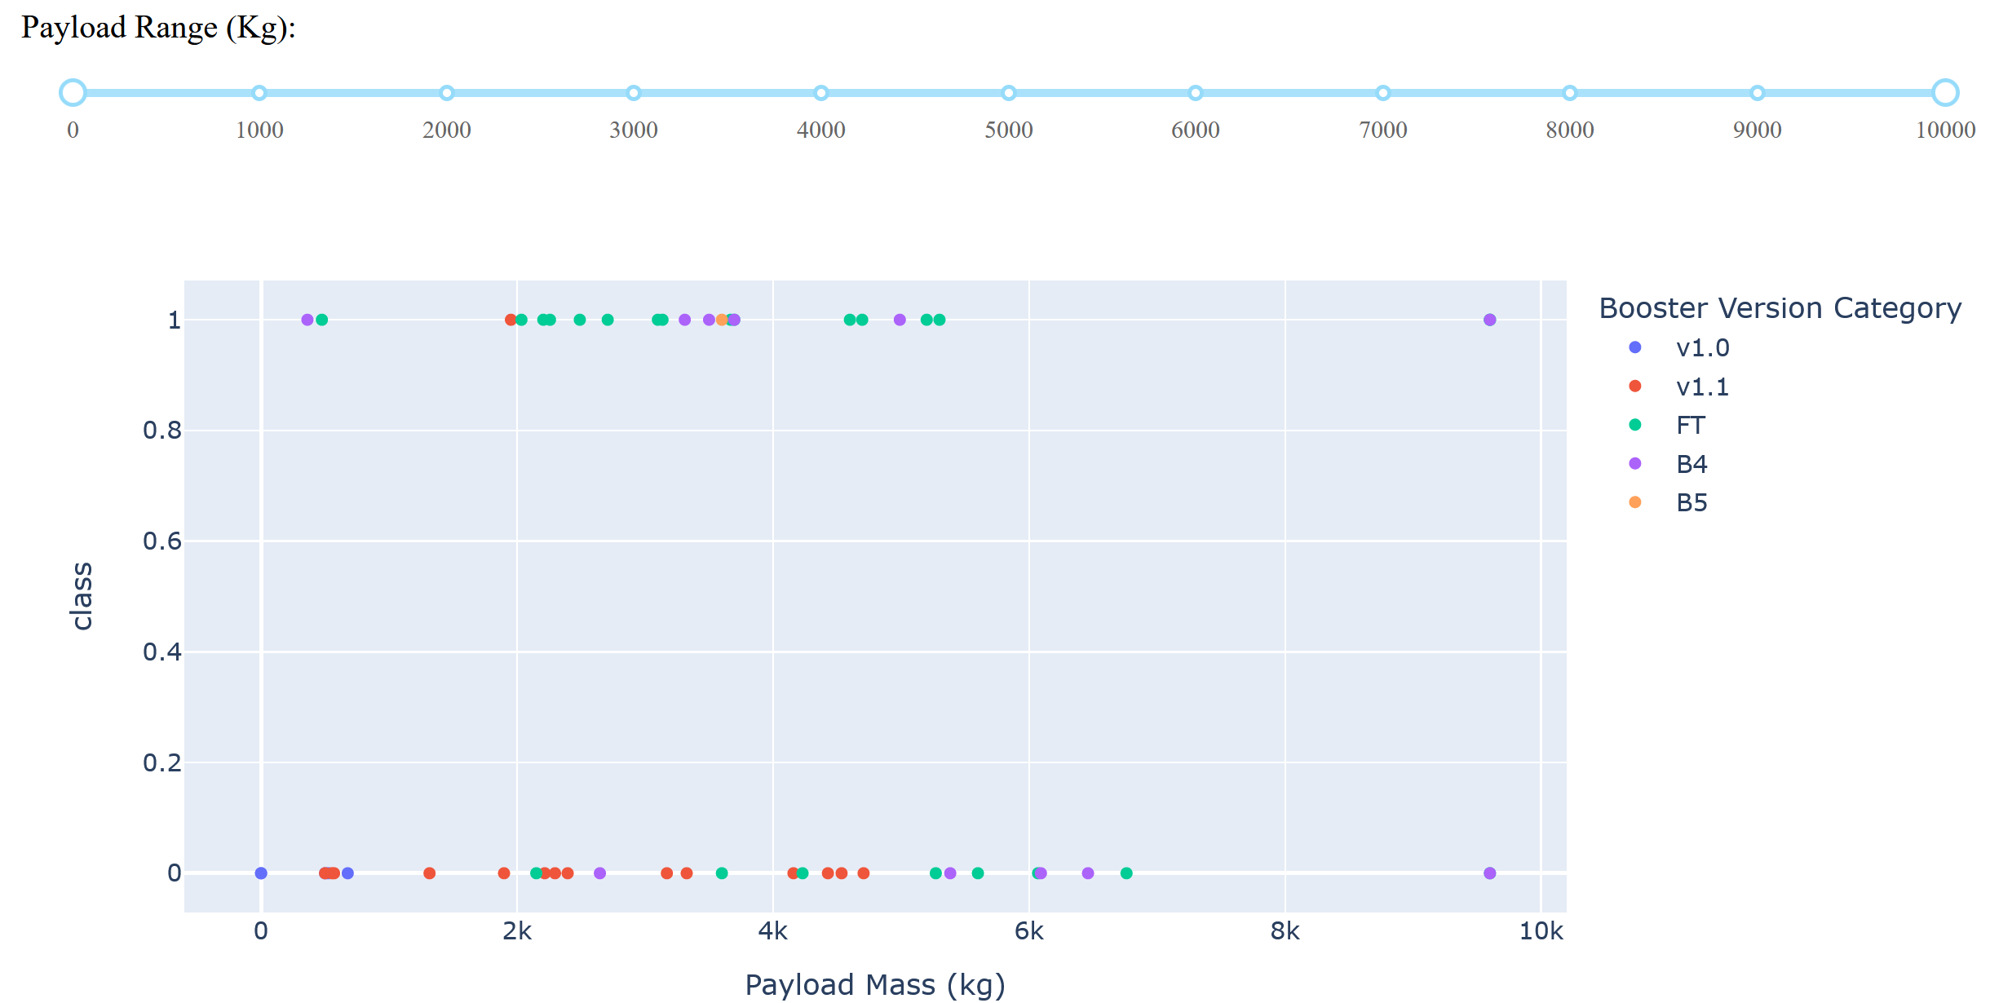
RESULTS
Interactive Visual Analytics with Plotly and Dash
Considering Payload Mass and Success by Booster Version (F9 Booster version FT has the highest launch success rate). as the highest launch success rat

Slide 40
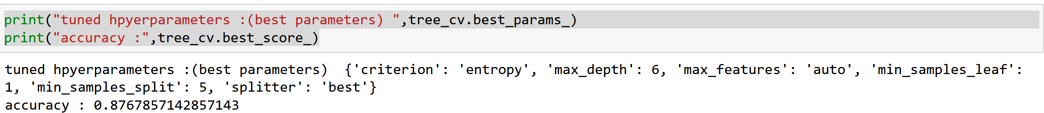
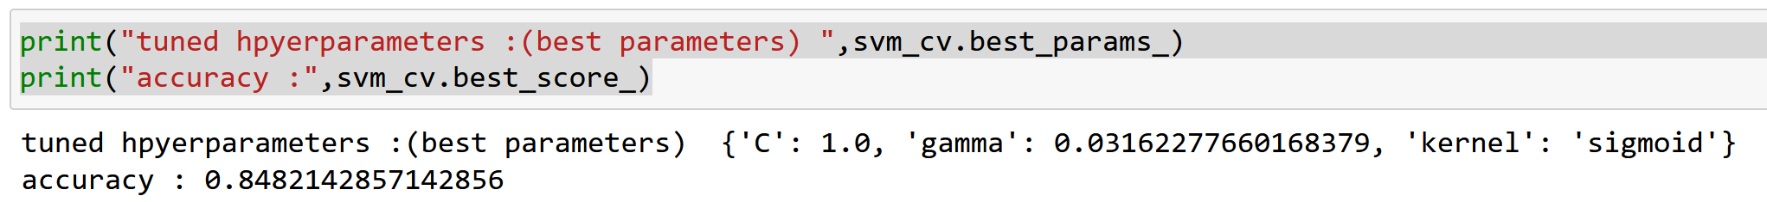
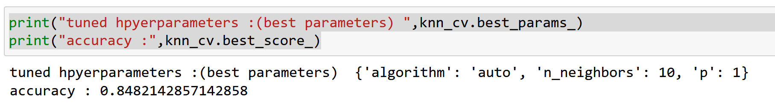
RESULTS
Predictive Analysis Results
Compare Accuracy of all models (Decision Tree is the best with Accuracy of 0.8768)as the highest launch success rat

Slide 41
OVERALL FINDINGS & IMPLICATIONS
Findings
All site are near equator line
All sites are near the coast
No much difference in accuracy among the used methods
With time launch success increased
Implications
Low fuel consumption
High safety to surroundings
Selection of any methods mentioned for predict is okay
Models should be trained with more data for better results.

Slide 42
OVERALL FINDINGS & IMPLICATIONS
Findings
Some orbits(S-L1, GEO, HEO, and SSO) have success rate of 100%.
There is a huge difference in success rate among the sites (KSC LC-39A has the highest success rate)
There is a range of payload mass that has high success rate(2000kg to 5000kG)
Implications
Selection of orbit is important for high success rate.
Selection of launching site is important for high success rate.
Payload mass per booster version should be within the proper range for high success rate.

Slide 43

CONCLUSION
Project showed that data science can well predict if first launch can land successfully.
More dataset is needed to increase accuracy in prediction.
For generalization of results, needed to include data far away from equator line.
Data preprocessing with methods(Multiscale Principal Component Analysis(MSPCA)) that reduce dimension should be used for accuracy prediction
Methods that can compare results from multiple methods (Bayser thorem) should be used to decide the final answer for reliable classfication results.

Slide 44

APPENDIX
Source Codes are found at:
ramadhani28/AppliedDataScienceCapstone (github.com)

